Slide 1
🌾 Agricultural Data Analysis

Slide 2
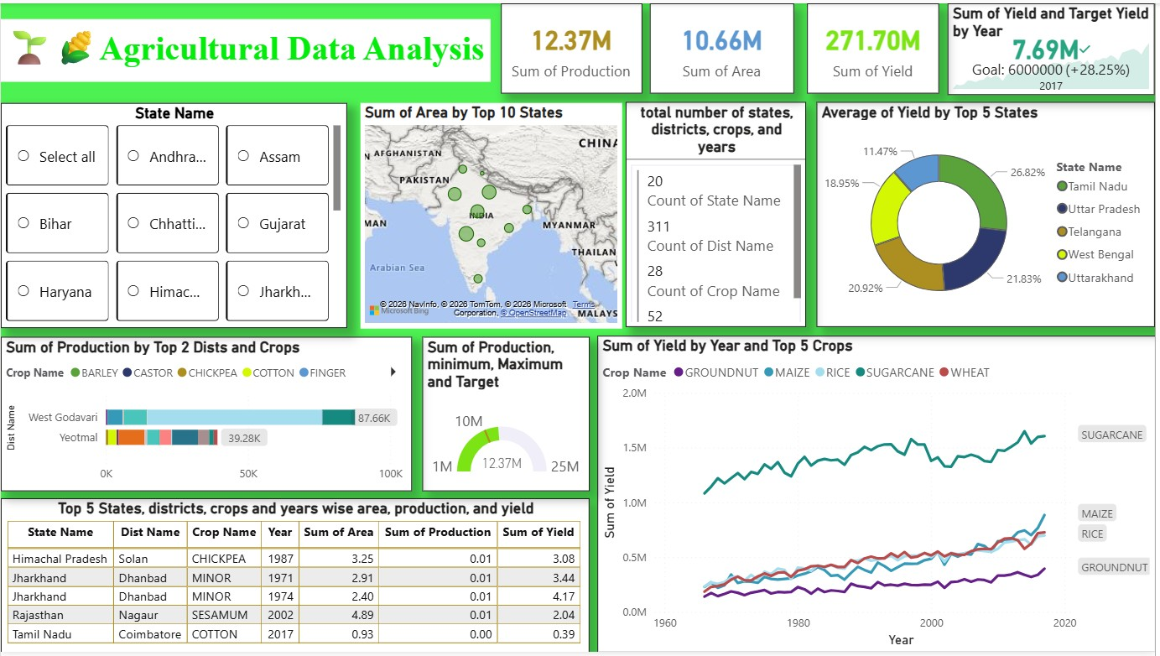
Dashboard Overview
This dashboard analyzes agricultural data at district and state level.
It helps to understand production, area, and yield patterns.
Provides geographical and trend-based insights.
Allows interactive filtering using slicers.

Slide 3
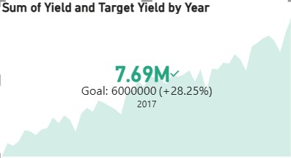
Key Performance Indicators (KPIs)
This visual represents the comparison between the actual agricultural yield and the target yield for the year 2017.
The dashboard shows that the total yield achieved was 7.69 million tonnes.
The expected or target yield for that year was 6 million tonnes.
When we compare both values, we can see that the actual production exceeded the target by 28.25%.
This indicates improved agricultural productivity, which may be due to better farming techniques, favorable weather conditions, or improved crop management.
Overall, this KPI helps stakeholders understand whether agricultural production goals are being successfully achieved.

Slide 4
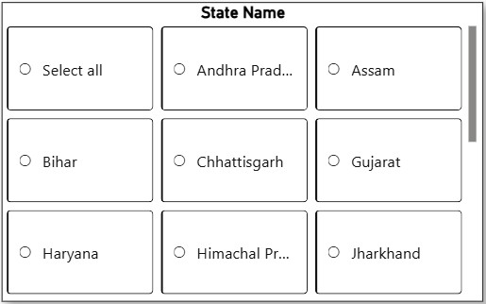
Slicer
This is a State Name slicer.
It is used to filter the dashboard data based on selected states.
If we select any state, the charts and graphs in the dashboard will show data only for that selected state.
If we click ‘Select all’, it will display data for all states.
This helps users quickly analyze and compare agricultural data state-wise.

Slide 5
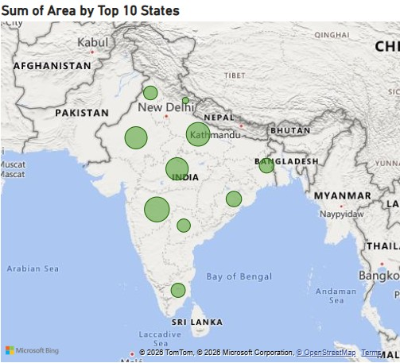
Map
This is a map visual showing the agricultural area of the top 10 states.
Each green circle represents a state.
The size of the circle shows how large the agricultural area is in that state.
Bigger circles mean the state has more farming area.
Smaller circles mean the state has less farming area.
This map helps us understand which states have the highest agricultural land.

Slide 6
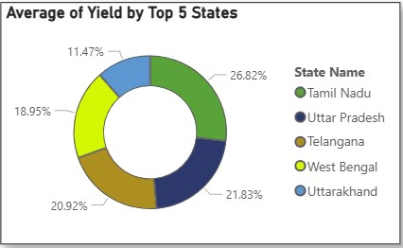
Donut Chart
This chart shows the average crop yield of the top 5 states.
Each color in the chart represents one state.
From this chart, we can easily compare which state produces more yield and which produces less.

Slide 7
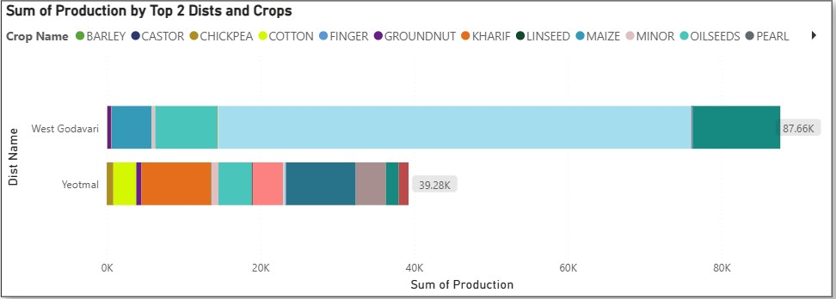
Stacked Bar Chart
This chart shows crop production in the top two districts.
Each bar represents a district, and different colors inside the bar represent different crops.
The total bar length shows total production, helping us compare crop contribution between districts.

Slide 8
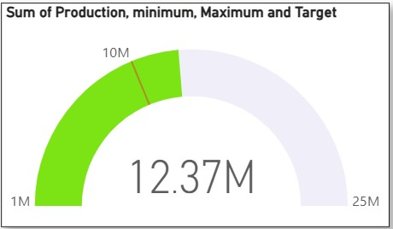
Performance Gauge
This gauge chart shows total crop production compared with minimum, maximum, and target values.
The current production is 12.37 million, which is shown by the pointer. It helps us understand whether production is low, average, or close to the target.

Slide 9
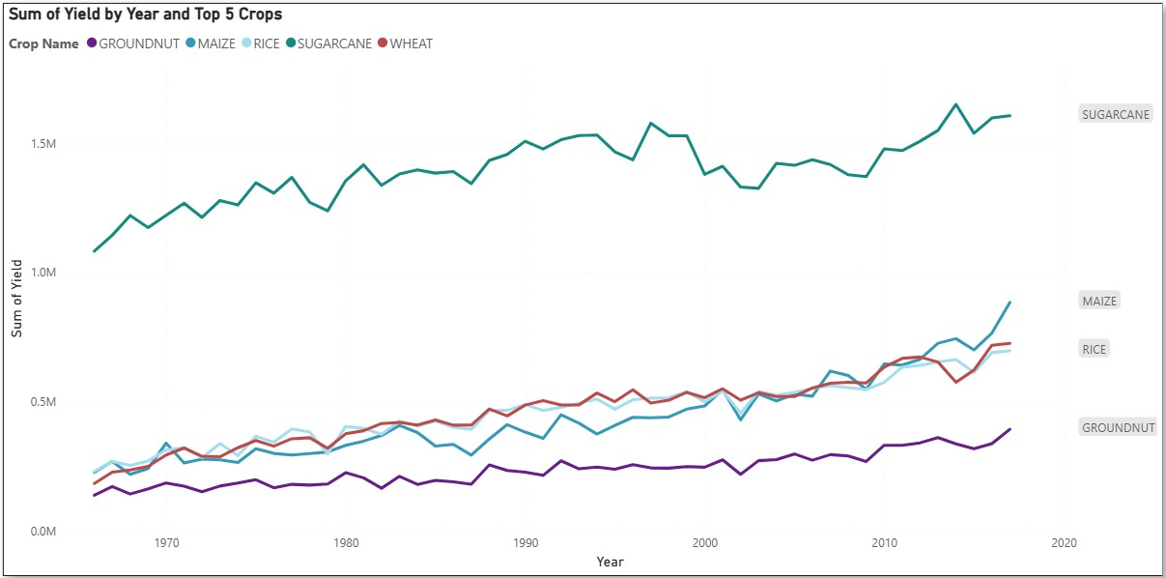
Line Chart
This line chart shows how crop yield has changed over the years for the top five crops.
Each colored line represents a different crop.
By observing the lines, we can understand which crops have increasing or decreasing yield trends over time.
It helps us identify crop performance and growth patterns across different years.

Slide 10
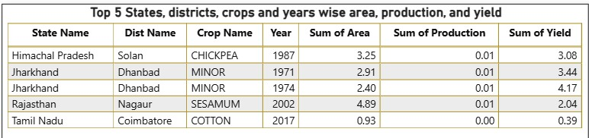
Table
This table shows detailed agricultural data for the top 5 states and districts.
It displays crop names, years, area used for cultivation, total production, and yield values.
This table helps us view exact data values and compare agricultural performance across different locations and crops.

Slide 11
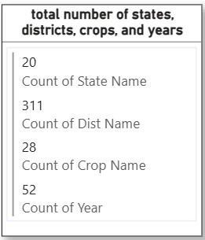
Multi Row Card
This multi-row card shows the total count of important agricultural data categories.
It displays the number of states, districts, crop types, and years available in the dataset.
This helps us understand the overall data coverage used in the dashboard.

Slide 12
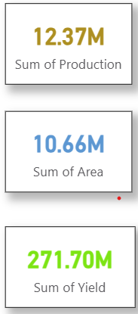
Cards
These cards show the overall summary of agricultural performance in the dataset.
12.37M – Sum of Production
Shows the total crop production across all states, districts, crops, and years.
10.66M – Sum of Area
Represents the total agricultural land area used for cultivation.
271.70M – Sum of Yield
Indicates the total crop yield, which reflects how much crop was produced from the cultivated land.

Slide 13
Conclusion
Dashboard provides complete agricultural performance insights.
Helps identify high production regions and crops.
Supports data-driven agricultural decision making.

Slide 14
Thank You

